Slide 1
Sequence Based ANN Models
Instructor: Revendranath T

Slide 2
Sequence Based ANN Models
Handle data with dependency on sequence
Examples:
Time series
Text data
ANN Models
Recurrent Neural Networks
Long Short-Term Memory
Transformers

Slide 3
Sequence Based ANN Models
How to construct/design sequence-based ANN Models?

Slide 4
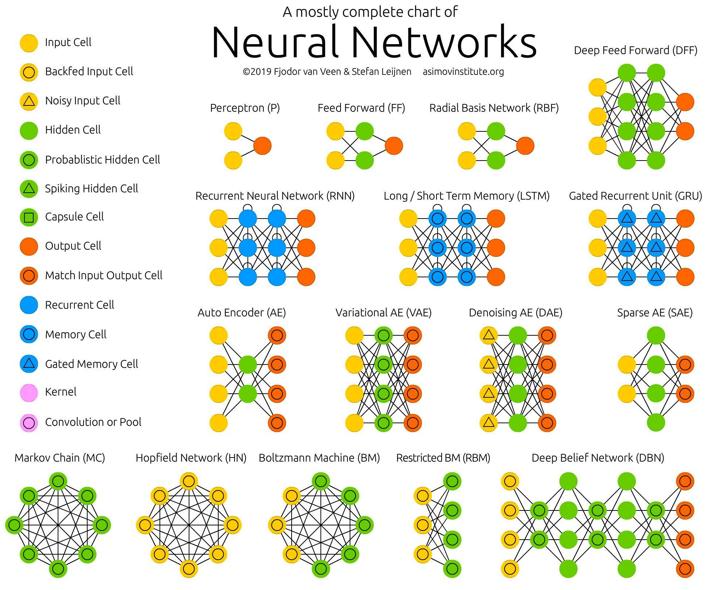
ANN Models Architectures

Slide 5
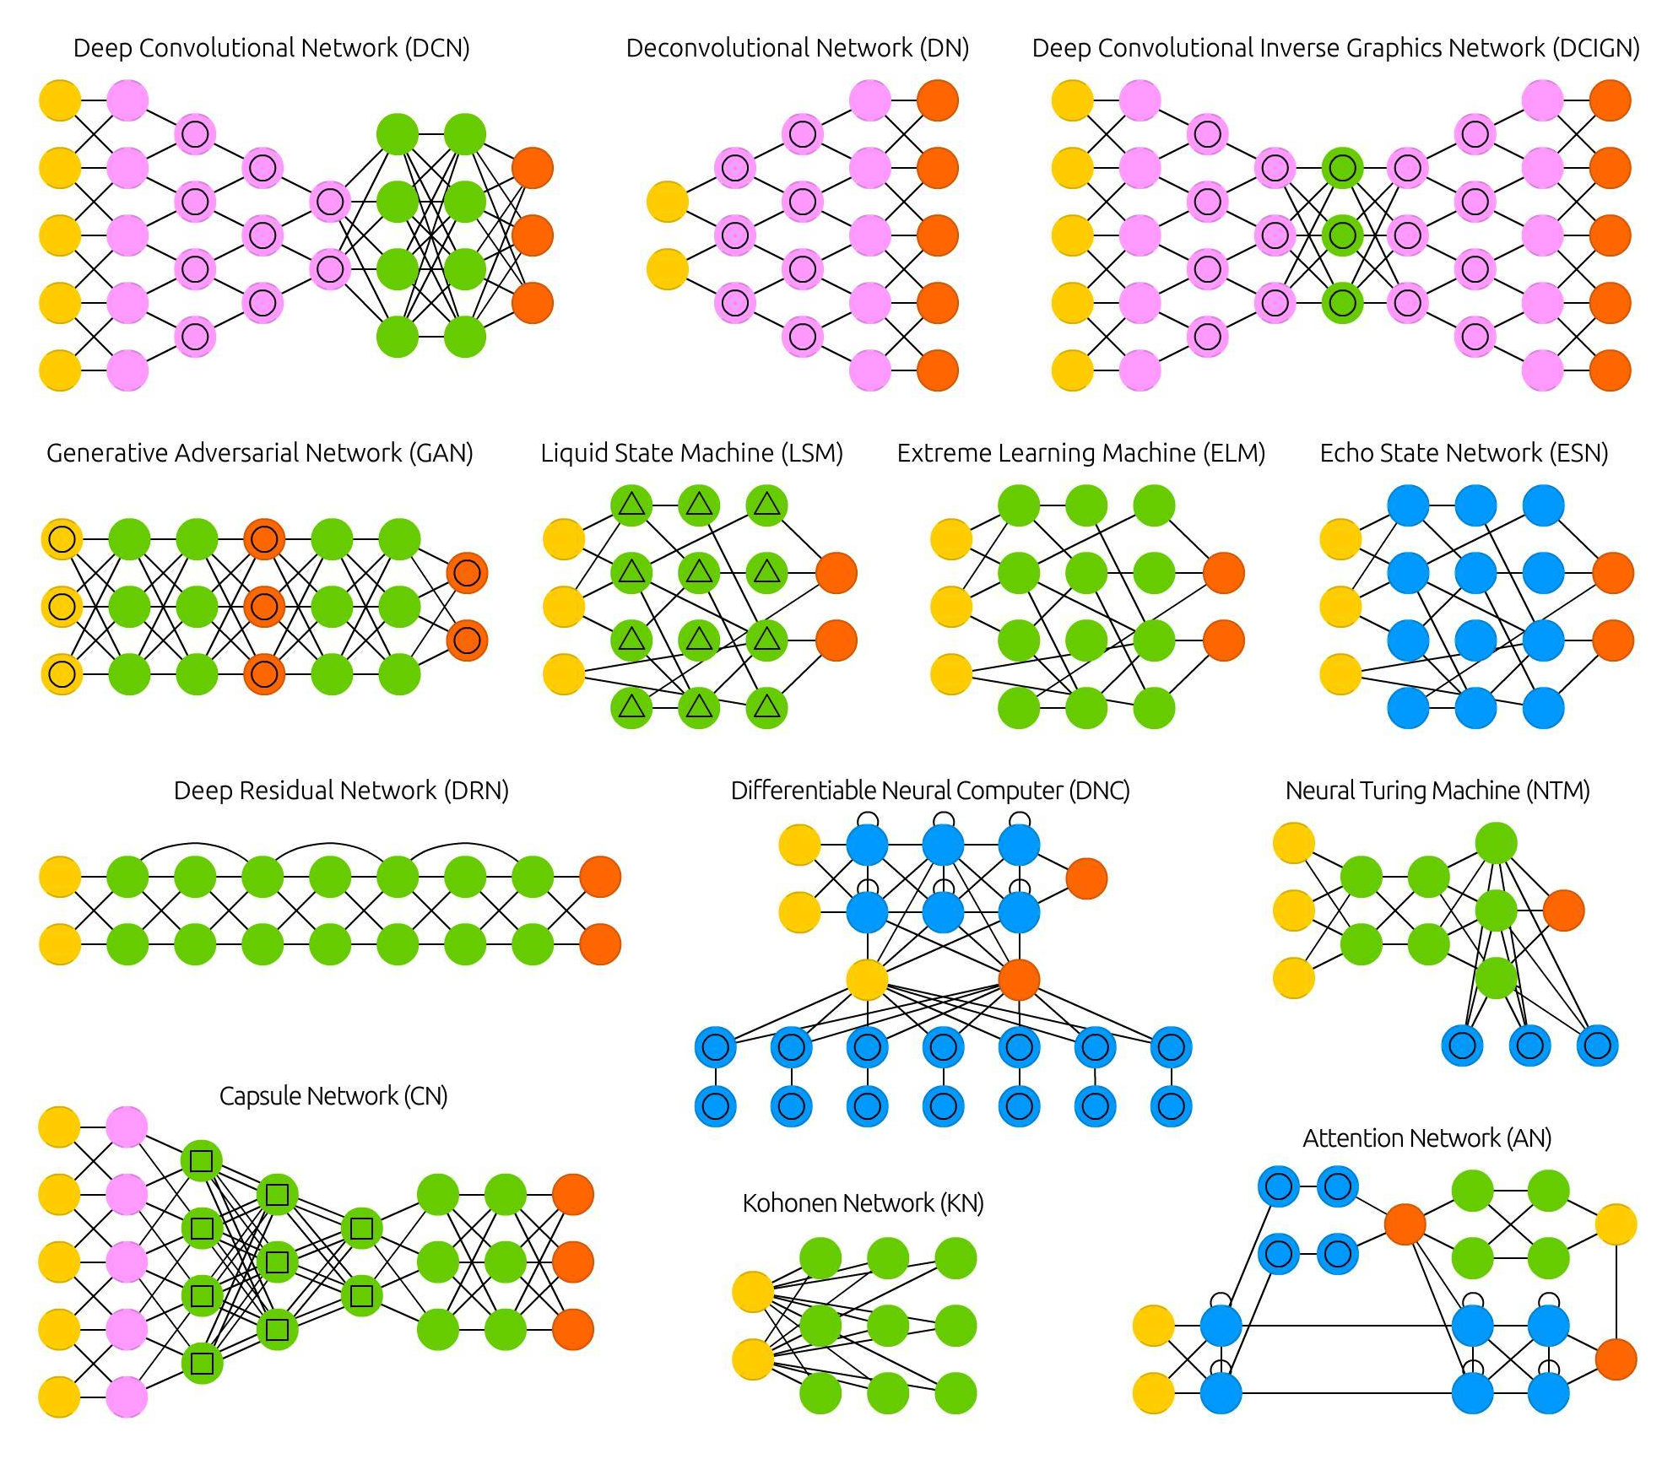
ANN Models Architectures

Slide 6
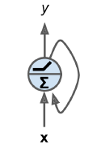
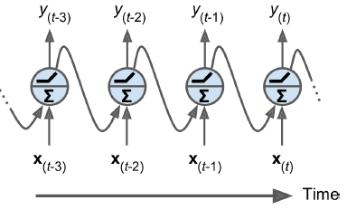
Recurrent Neuron Layers
Looks very much like a feedforward neural network, along with connections pointing backward.
The simplest RNN composed of
one neuron receiving inputs,
Producing an output, and
sending that output back to itself
At each time step t (also called a frame), the recurrent neuron receives the inputs x(t) as well as its own output from the previous time step, y(t–1).
Since there is no previous output at the first time step, it is generally set to 0.

Slide 7
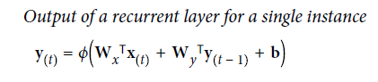
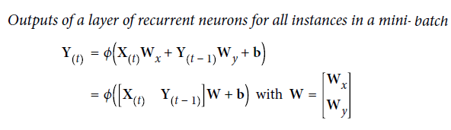
RNN: Mathematical Representation

Slide 8
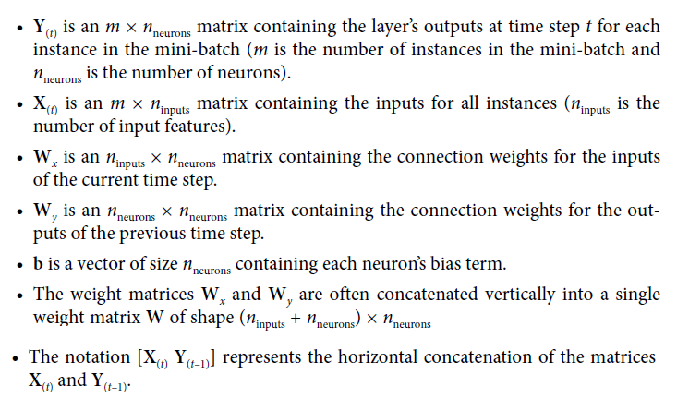
RNN: Mathematical Representation

Slide 9
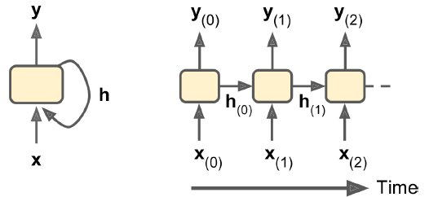
Memory Cells
Memory: the output of a recurrent neuron at time step t is a function of all the inputs from previous time steps, and RNN has a form of memory.
Memory cell: a part of a neural network that preserves some state across time steps.
A single recurrent neuron, or a layer of recurrent neurons, is a very basic cell, capable of learning only short patterns
typically about 10 steps long, but this varies depending on the task
Cell’s state at time step t, denoted h_{(t)} (the “h” stands for “hidden”)
function of inputs at that step and and the state at previous steps: h(t) = f(h(t–1), x(t))
Its output at time step t, denoted y(t), is also a function of the previous state and the current inputs.

Slide 10
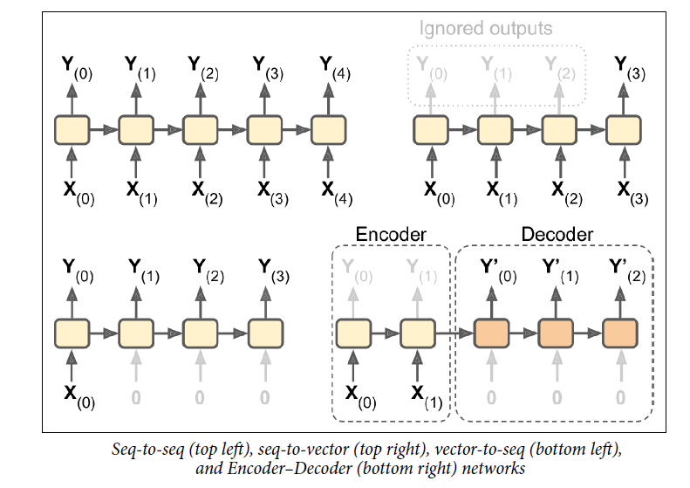
Input & Output Sequences of RNN

Slide 11
Input & Output Sequences of RNN
Name of RNN | Input | Output | Application
Sequence-to-sequence Network | Feed sequence of inputs | Produce a sequence of outputs | useful for predicting time series such as stock prices feed the prices over the last N days, and it must output the prices shifted by one day into the future
Sequence-to-vector network | Feed sequence of inputs | Vector output (ignore all outputs except for the last one) | Input a sequence of words corresponding to a movie review, and the network would output a sentiment score
Vector-to-sequence network | Feed the RNN same input vector over and over again at each time step |  | The input could be an image (or the output of a CNN), and the output could be a caption for that image.
Encoder (sequence-to-vector network) followed by Decoder (vector-to-sequence network) | Feed sequence of inputs | Produce a sequence of outputs | Used for translating a sentence from one language to another Feed sentence sequence in one language as input to encoder Produce sentence sequence in another language from decoder

Slide 12
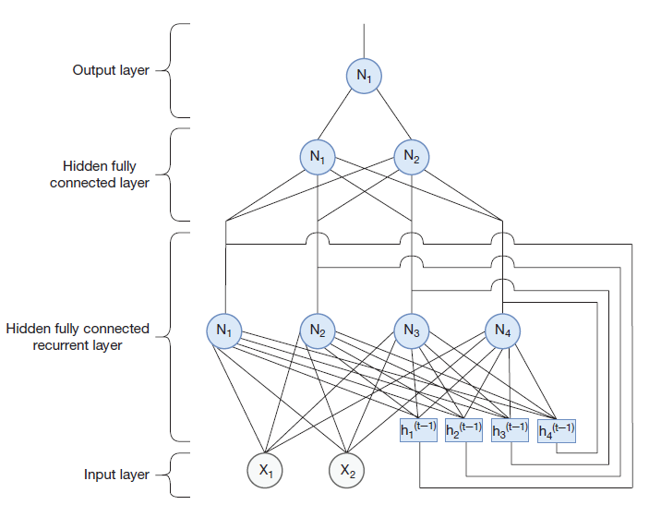
RNN Architecture

Slide 13
Training RNNs
Backpropagation through time (BPTT): training strategy of RNNs
Unroll the input through time
Apply back-propogation technique on neural networks
Use regular backpropagation in first forward pass through the unrolled network (represented by the dashed arrows).
Evaluate the output sequence using a cost function C(Y(0), Y(1), …Y(T))
where T is the max time step
The gradients of that cost function are then propagated backward through the unrolled network (represented by the solid arrows)
Finally, the model parameters are updated using the gradients computed during BPTT.
The gradients flow backward through all the outputs used by the cost function

Slide 14
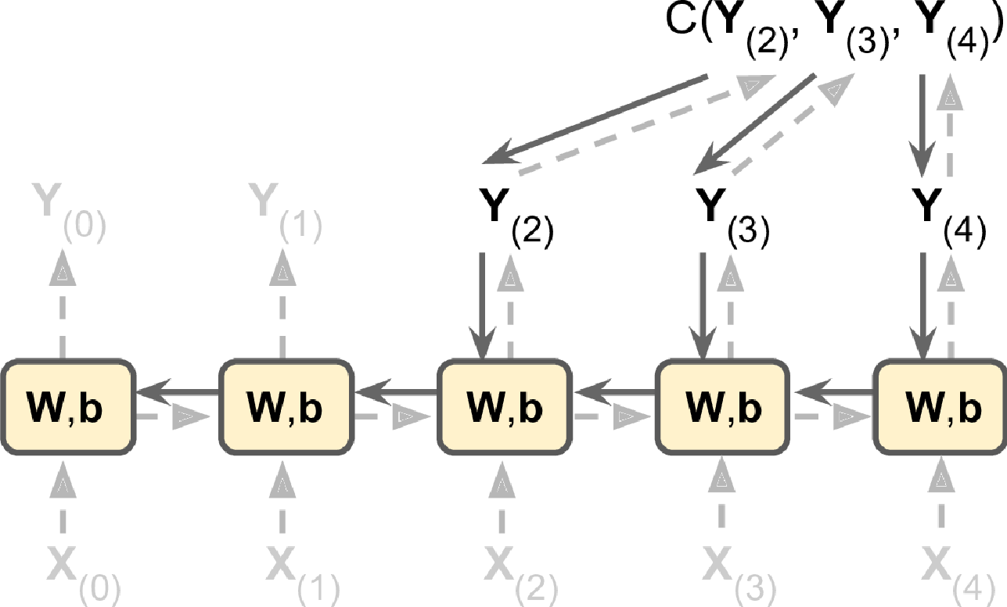
Training RNNs : Backpropagation Through Time

Slide 15
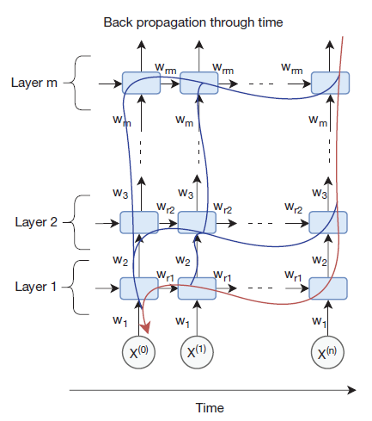
Training RNNs : Backpropagation Through Time

Slide 16
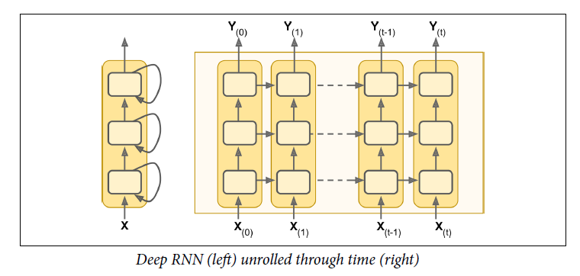
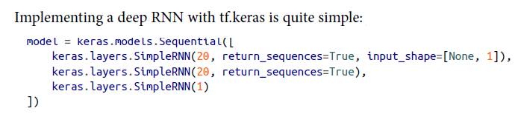
Deep RNNs

Slide 17
The Short-Term Memory Problem
Due to the transformations that the data goes through when traversing an RNN, some information is lost at each time step.
After a while, the RNN’s state contains virtually no trace of the first inputs.
This leads to loss of memory in the long term, and only short-term memory is retained.
To tackle this problem, various types of cells with long-term memory have been introduced.
The different types of cells have proven so successful that the basic cells are not used much anymore.
Popular cells:
the LSTM cell.
the GRU cell

Slide 18
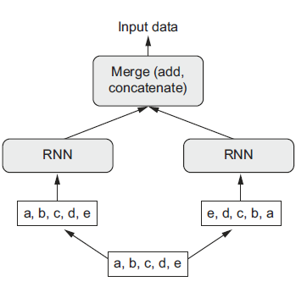
Bidirectional RNN

Slide 19
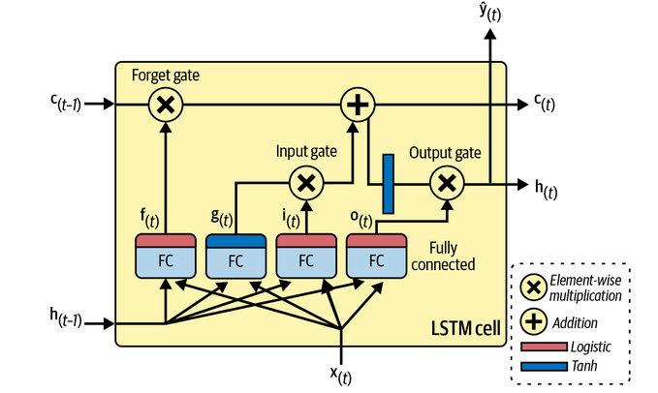
LSTM

Slide 20
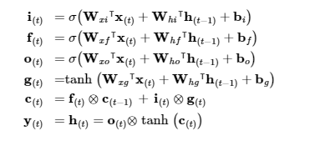
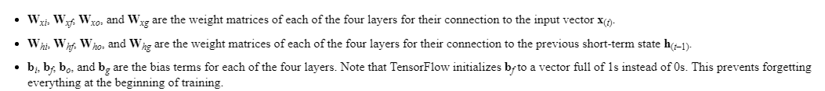
LSTM

Slide 21
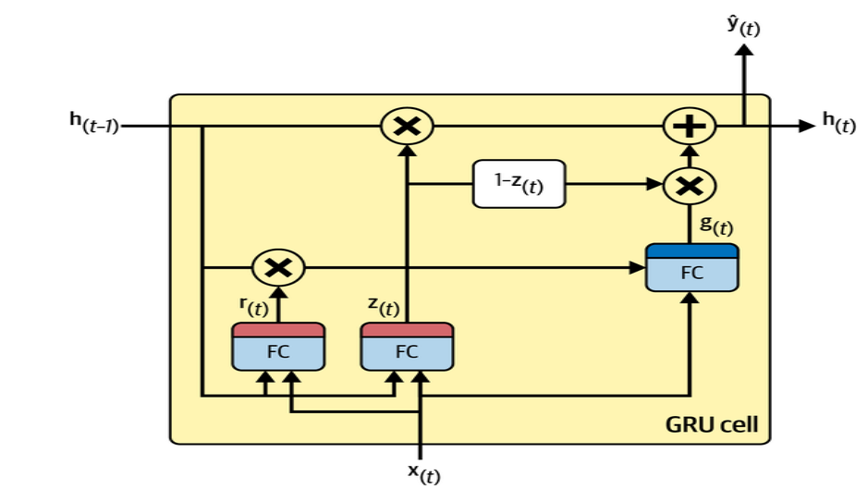
GRU Cell

Slide 22
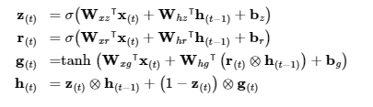
GRU Cell

